Slide 1

Mutual Fund Analytics Suite
An End-to-End Analytics Platform for Fund Performance, Investor Demographics, and SIP Market Trends
Prepared by: Kunal Ahire | Data Analyst Intern

Slide 2


Executive Overview & Architecture
Project Objective
Technical Architecture
Designed and deployed an interactive 4-page Business Intelligence suite enabling fund managers to analyze macro sector trends, risk-adjusted returns, investor demographics, and systematic inflows.
Built on a robust Star Schema Data Model integrating PostgreSQL data pipelines, Python EDA scripts (`scipy`, `pandas`), and optimized Power BI DAX measures for real-time aggregation.

Slide 3






Page 1: Industry & Fund Overview
AUM Growth
Category Split
AMC Market Share
Tracks aggregate Assets Under Management (AUM) trends across AMC fund houses with macro-level category distribution.
Evaluates asset allocation proportions across Equity, Hybrid, Debt, and Index/Passive fund categories.
Ranks major Asset Management Companies by market capital share and active folio counts.

Slide 4

Page 2: Fund Performance & Risk Analysis
Risk-Adjusted Return Metrics
Computes risk metrics across 40 schemes against standard market benchmarks (Nifty 50 / Nifty 100):
8.4%
•
Sharpe & Sortino Ratios: Standard risk-adjusted returns using RBI Repo Rate proxy (6.5%).
Avg 3-Year CAGR
•
Alpha & Beta Indicators: OLS regression against benchmark indices.
•
Fund Scorecard (0-100): Composite rating based on CAGR, Sharpe ratio, and Inverse Expense Ratio.

Slide 5
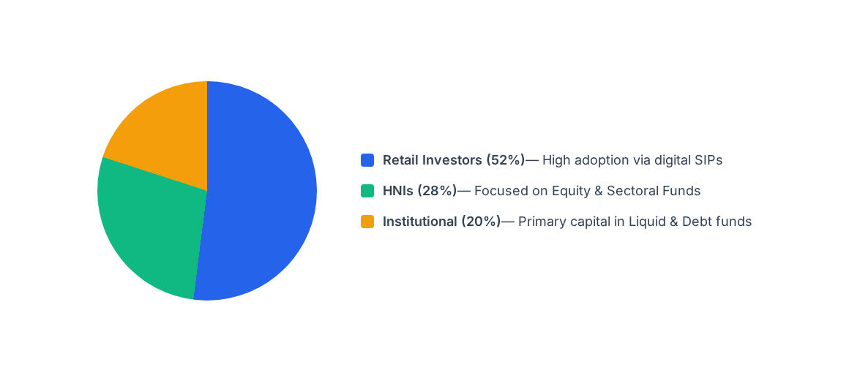
Page 3: Investor Demographics & Behavioral Profiling

Slide 6
Page 4: SIP Trends & Historical Inflows
SIP Growth Tier | Avg Ticket Size | Dominant Age Group | Key Growth Factor
Tier 1 Cities | ₹3,500 / month | 25–38 Years | Digital Onboarding & Tax Saving (ELSS)
Tier 2 Cities | ₹2,000 / month | 30–45 Years | Financial Inclusion & AMC Awareness
Tier 3 Cities | ₹1,000 / month | 22–35 Years | Micro-SIP Adoption & Mobile Apps

Slide 7
Thank You!
Bluestock FinTech Mutual Fund Analytics Suite Project Completed Successfully.

